Slide 1
Advanced Microcontrollers & Applications (EC-506)
Class: ECE- 5th Semester
Academic session: Aug-Dec, 2020

Slide 2
(SECTION-B)
Embedded System Applications(Arduino)

Slide 3
Line Follower Robot
A Line follower robot is an electronic system that can detect and follow the line drawn on the floor.
Generally, the line is specified a predefined path that can be either visible like a black line on a white surface with a high contrasted color.

Slide 4
Types of line follower robots:
Black line follower, which follows the black line
White line follower, which follows the white line.
Applications : Factory floor management and in warehouses, in health care management system (Covid Care wards in hospitals for medicine and food supply).

Slide 5
Concept of Line Follower
The concept of working of line follower is related to light.
The behavior of light at the black and white surfaces is used.
When light falls on a white surface it is almost fully reflected and in the case of a black surface light is completely absorbed. This behavior of light is used in building a line follower robot.

Slide 6
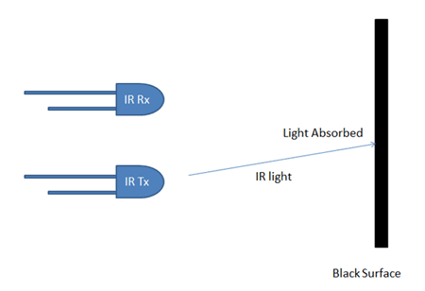
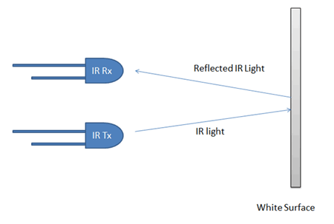
Concept of line Follower (Contd.)

Slide 7
In this Arduino based line follower robot
IR (infrared) Transmitters (IR LED) and IR (infrared) receivers (TSOP 1738) also called as photodiodes are used. They are used for sending and receiving light. IR transmits infrared lights ( wavelen
When infrared rays falls on the white surface, it’s reflected back and caught by photodiodes which generate some voltage changes. When IR light falls on a black surface, light is absorbed by the black surface and no rays are reflected back, thus photo diode does not receive any light or rays.
In this Arduino line follower robot when the sensor senses white surface then Arduino gets 1 as input and when senses black line , Arduino gets 0 as input.

Slide 8
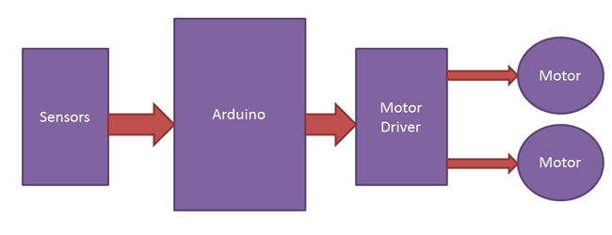
Functional Blocks of Line Follower Robot

Slide 9
Arduino line follower robot can be divided into 3 sections:
1) Sensor section:
IR Module which is a sensor circuit consists of IR diodes, potentiometer, Comparator (Op-Amp) and LED’s. The potentiometer is used for setting reference voltage at comparator’s one terminal and IR sensors are used to sense the line and provide a change in voltage at the comparator’s second terminal. Then the comparator compares both voltages and generates a digital signal at the output. Here in this line follower circuit, two comparators for two sensors are used.
LM 358 is used as a comparator. LM358 has inbuilt two low noise Op-amps.

Slide 10
2) Control section:
Arduino UNO is used for controlling the whole process of the line follower robot. The outputs of comparators are connected to digital pin numbers 2 and 3 of Arduino. Arduino read these signals and send commands to driver circuit to drive line follower.
3) Driver section:
The driver section consists of motor driver IC ( L293D) and two DC motors. The motor driver is used for driving motors because Arduino does not supply enough voltage and current to the motor. So adding a motor driver circuit to get enough voltage and current for the motor. Arduino sends commands to this motor driver and then it drives motors.

Slide 11
Working of Line Follower Robot
The line follower robot senses a black line by using a sensor and then sends the signal to Arduino. Then Arduino drives the motor according to sensors' output.
Two IR sensor modules namely the left sensor and the right sensor are used.

Slide 12
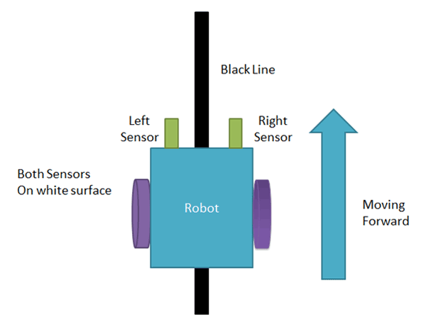
When both left and right sensor senses white then the robot moves forward.

Slide 13
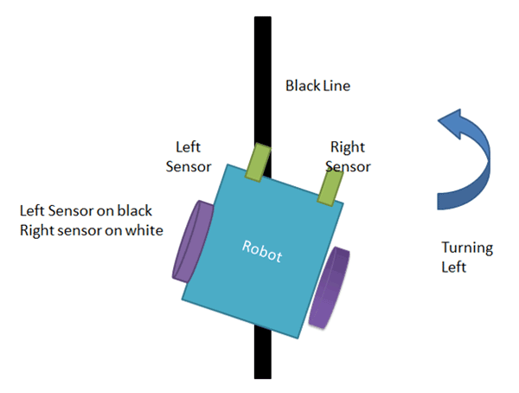
If the left sensor comes on a black line then the robot turn the left side

Slide 14
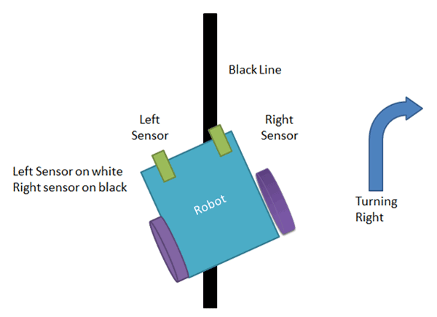
If the right sensor sense black line then robot turn right side until both sensors comes at the white surface. When the white surface comes robot starts moving on forward again.

Slide 15
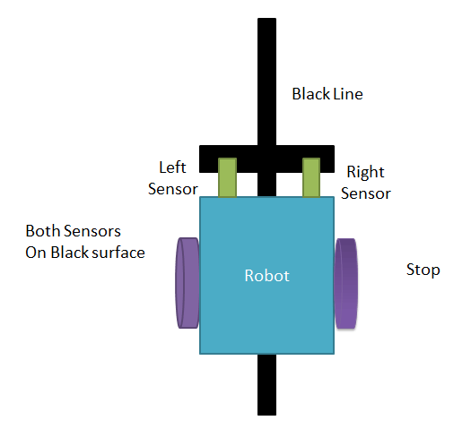
If both sensors come on the black line, the robot stops.

Slide 16
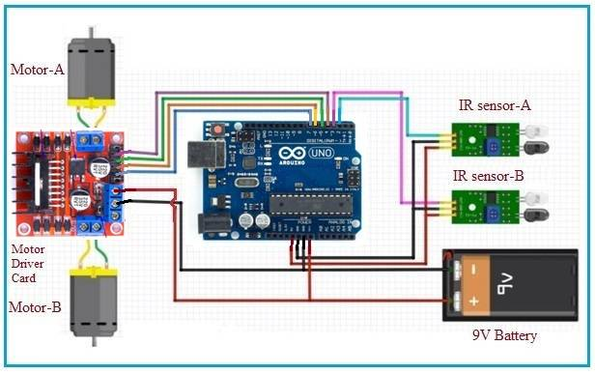
Circuit Diagram

Slide 17
The output of comparators is directly connected to Arduino digital pin number 2 and 3. And motor driver’s input pin 2, 7, 10 and 15 is connected to Arduino's digital pin number 4, 5, 6 and 7 respectively. And one motor is connected at the output pin of motor drivers 3 and 6 and another motor is connected at pin 11 and 14.

Slide 18
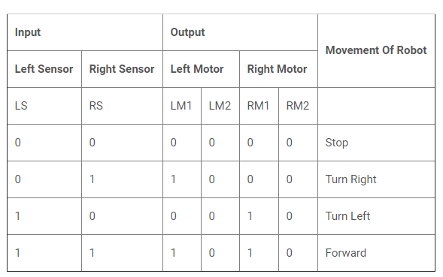
Program

Slide 19
/*------ Arduino Line Follower Code----- */ /*-------defining Inputs------*/ #define LS 2 // left sensor #define RS 3 // right sensor
/*-------defining Outputs------*/ #define LM1 4 // left motor #define LM2 5 // left motor #define RM1 6 // right motor #define RM2 7 // right motor
void setup() { pinMode(LS, INPUT); pinMode(RS, INPUT); pinMode(LM1, OUTPUT); pinMode(LM2, OUTPUT); pinMode(RM1, OUTPUT); pinMode(RM2, OUTPUT); }
void loop() { if(digitalRead(LS) && digitalRead(RS)) // Move Forward { digitalWrite(LM1, HIGH); digitalWrite(LM2, LOW); digitalWrite(RM1, HIGH); digitalWrite(RM2, LOW); }

Slide 20
if(!(digitalRead(LS)) && digitalRead(RS)) // Turn right { digitalWrite(LM1, LOW); digitalWrite(LM2, LOW); digitalWrite(RM1, HIGH); digitalWrite(RM2, LOW); } if(digitalRead(LS) && !(digitalRead(RS))) // turn left { digitalWrite(LM1, HIGH); digitalWrite(LM2, LOW); digitalWrite(RM1, LOW); digitalWrite(RM2, LOW); } if(!(digitalRead(LS)) && !(digitalRead(RS))) // stop { digitalWrite(LM1, LOW); digitalWrite(LM2, LOW); digitalWrite(RM1, LOW); digitalWrite(RM2, LOW); } }

Slide 21
Functional Blocks of Accelerometer based Hand Gesture Controlled Robot
In accelerometer based gesture control robot hand motion is used to drive the robot.
An accelerometer is an electromechanical device that will measure acceleration force. It shows acceleration, only due to cause of gravity i.e. g force. It measures acceleration in g unit.
On the earth, 1g means acceleration of 9.8 m/s2 is present

Slide 22
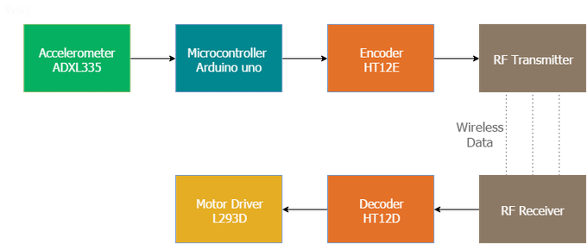
Functional blocks of Accelerometer based Gesture controlled Robot

Slide 23
Accelerometer(ADXL335) module
The ADXL335 is a small, low power, complete 3-axis(X,Y,Z) accelerometer with signal conditioned voltage outputs.
It can measure the static acceleration of gravity in tilt-sensing applications, as well as dynamic acceleration resulting from motion, shock, or vibration.
This module measures acceleration within range ±3 g in the x, y and z axis.
The output signals of this module are analog voltages that are proportional to the acceleration.

Slide 24
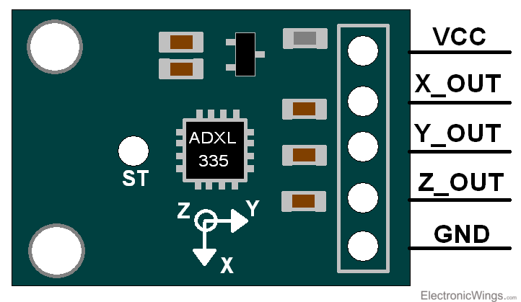
ADXL335 Pin out Configuration

Slide 25
ADXL335 Accelerometer module consists of six pins i.e. VCC ( 5V), GND, X, Y, Z, and ST ( self test) .
Connect VCC and GND pins to 5V and GND pins of Microcontroller ( arduino). Also connect X, Y, and Z pins to the Analog pins of Arduino.

Slide 26
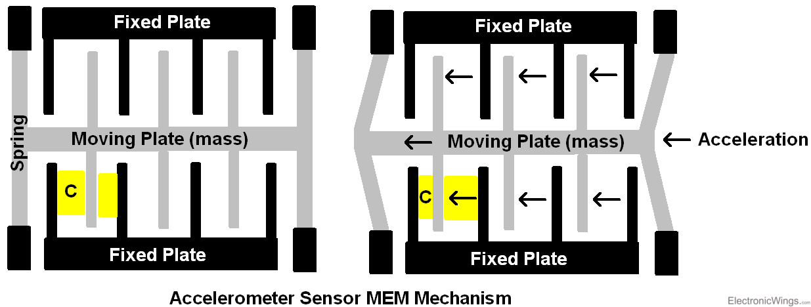
Working Mechanism of Accelerometer

Slide 27
Basic structure of accelerometer consists fixed plates and moving plates (mass).
When the acceleration is applied on an axis, capacitance between fixed plates and moving plates is changed. This results in a sensor output voltage amplitude which is proportional to the acceleration.

Slide 28
This system can be divided into two sections:
1) Transmitter section:
Accelerometer ( ADXL335)
Arduino UNO
Encoder (HD 12E)
RF transmitter ( 434MHz)
2) Receiver Section:
RF receiver (434MHz)
Decoder (HT12D)
Motor Driver (L293D)

Slide 29
RF transmitter and Receiver:
The communication between transmitter and receiver is using RF modules. A 434 MHz transmitter and receiver pair are used

Slide 30
RF Encoder/Decoder pair
Encoder (HT12E):
It is an encoder IC that converts the 4-bit parallel data into serial data in order to transmit over RF link.
Decoder HT-12D:
It is a decoder IC that converts the serial data received by the RF Receiver into 4-bit parallel data. This parallel data can be used to drive the motors.

Slide 31
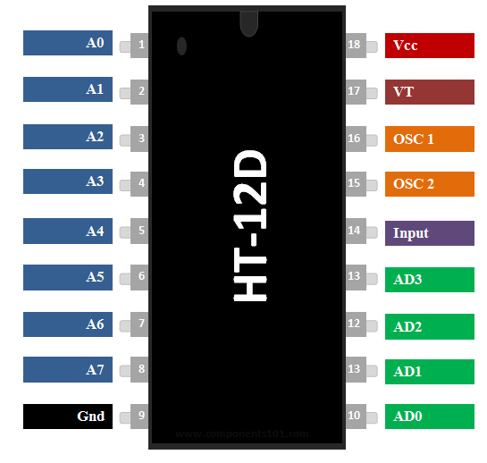
HD12D RF Decoder IC pinout

Slide 32
Pinout description

Slide 33
How to use HT12D decoder
The IC HT12D can be used only with its pair HT12E.
These two ICs together form an Encoder and Decoder pair.
They are 12-bit Encoders/Decoders, they can transmit 12-bit a data among them.
Encoder and Decoder IC pair will share a common Address which is an 8-bit data.
So out of the 12-bits, 8-bits will be used to set address and the remaining 4-bit will be used to transmit data. With 4-bit data we can create 16 types (2^4 =16) of combinations. These IC’s are commonly used with RF pairs or IR pairs.
To transmit a 4-bit data from one end to other either by wire or wireless then this IC pair will be best suited.

Slide 34
Working of gesture controlled Robot
The accelerometer reads the X Y Z coordinates when we make gestures by hand and send the X, Y, Z coordinates to the Arduino. The Arduino checks the values of coordinates and sends a 4-bit code to the Encoder IC. The Encoder passes the data to the transmitter and the transmitted data is received by the RF receiver. The receiver sends the 4-bit code to the Decoder IC and the decoder passes it to Motor Driver IC. Later the motor driver makes the decision to turn the two motors in the required direction.

Slide 35


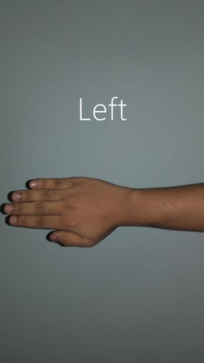


Gestures recognized by Robot

